Slide 1
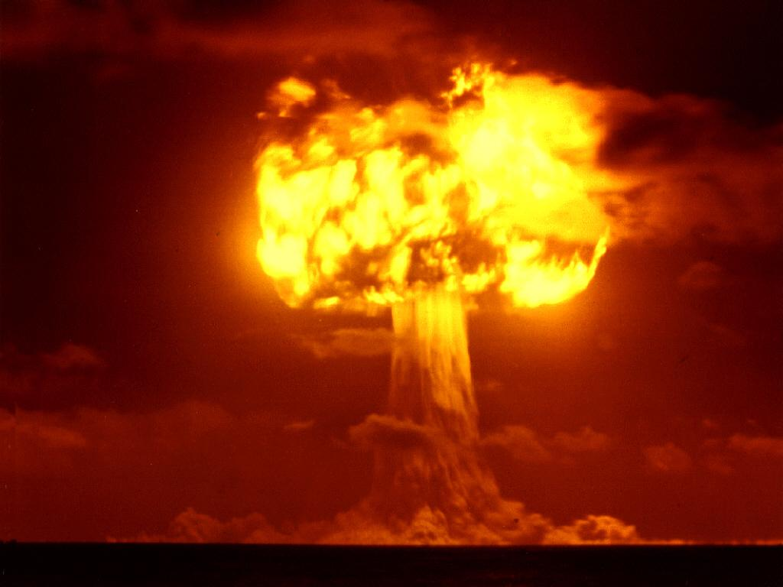
The Cold War 1945-1960

Slide 2
Politics
22nd Amendment (1951)
Limited president to two terms; or a maximum of 10 years if he, as vice president, assumed the presidency due to the death or departure of a previous president.
Largely a conservative move in the face of over 17 years of continuous Democratic rule in the White House (FDR and Truman)
FDR was elected 4 times, died just after 4th term began

Slide 3
Problems after WWII
“Iron Curtain" Speech
Winston Churchill, 1946 in Fulton, Missouri
Warns of Soviet (Communist) Expansion
Tensions between US and Soviet Union are high
Why would the Soviets be distrusting of U.S. ?
Why would Americans distrust Stalin?

Slide 4
Tensions between US and Soviet Union are high
US did not enter WWII early enough(Too many Russians died)
US didn’t include them in development of atomic bomb
Soviet Union had signed a pact with Hitler before the war to split up Poland
Soviets failed to leave Poland end of war.

Slide 5
US vs. Soviet 1945-1948
U.S.
Soviet Union
US wants to extend democracy & protect economic interests in Europe
Do this through the creation of United Nations
and
Aid to vulnerable nations
Soviets want to extend communism and have “friendly” border nations
Soviet Union denies elections, setting up communist governments in Eastern Europe (satellite nations)
Many rigged elections with communism winning

Slide 6
U.S. Foreign Policy
Containment
Stop communism from spreading
Truman Doctrine
Defined US foreign policy for next 20 years
US policy to support democracies in Europe against communist aggression
Used mainly to support Greece & Turkey against communists

Slide 7
U.S. Foreign Policy Continued…
Marshall Plan
Europe is in shambles economically
US pledges $13 Billion to rebuild Europe’s economy
Helps make many European nations “pro-US”
Most money goes to Western Europe
Russia is very angry!

Slide 8
Postwar Germany and Berlin

Slide 9
Conflict and Crisis
Berlin Airlift
Germany divided into occupation zones
US, French, & British combine their areas to form West Germany
Soviets upset; cut off all transportation to Berlin (capital in Soviet zone)
US afraid Berlin will fall to communism, begins airlifting supplies
Airlift lasts for nearly a year before Soviets back down

Slide 10
Conflict and Crisis
Western European Nations and US set up NATO
North Atlantic Treaty Organization
Created April 4, 1949 by 12 nations inc. U.S., France, Britain, Italy, Belgium, Netherlands, Luxembourg, Denmark, Norway, Portugal, Iceland, and Canada
Collective security organization that essentially warned Moscow that a threat to any of the signatories would be met with force.

Slide 11
Conflict Continued
China falls in 1949
Civil war after WWII between communists (Mao Zedong) and “democratic forces” (Chang Kai-shek)
Communists win in 1949
US refuses to recognize the Peoples Republic of China ("Red China")
People’s Republic of China not recognized as a permanent Security Council member until 1973.

Slide 12
Atomic Competition
The Hydrogen Bomb ( H-Bomb:67 times more powerful than A-bomb)
Soviets start developing in 1949, Completes in 1953
US uses/fully develops in 1952
Nuclear Arms Race now in full effect

Slide 13
The Korean War
1st major fighting of the Cold War
Soviets controlled N.Korea after WWII, US controls S.Korea (divide was 38th parallel)
N.Korea uses military aid from Soviets to invade S.Korea in 1950
The United Nations voted to send military to stop N.Korea (over 90% of troops were US)
UN troops were led by Douglas MacArthur
UN troops push N.Korea out of S.Korea
Continue push all the way to the Yalu River (China)
China enters the war to help N.Korea
UN troops are quickly pushed back into S.Korea, with the capitol of Seoul taken.

Slide 14
Korean War Continued
MacArthur urges Truman to use nuclear weapons on China
Truman is afraid of WWIII (Soviets would help)
MacArthur’s idea is rejected
MacArthur goes behind Truman’s back, continues push for war
Contacts Congressmen & Newspapers
Truman fires MacArthur
UN forces recapture Seoul; trench warfare ensues around 38th parallel
Soviets suggest a cease-fire in June, 1951
Demilitarized zone created at 38th parallel
Treaty takes 2 years to complete (July, 1953)
Armistice still in effect today
War is viewed as unsuccessful in US
54,000 US soldiers killed
$67 Billion War debt
Truman loses support of US public

Slide 15
Cold War at Home
US fears of communism grow (2nd Red Scare)
Truman sets up Federal Employees Loyalty Program
3.2 million Americans investigated from 1947-51
House Un-American Activities Committee (HUAC)
Investigated communist influence in movie industry
Hollywood Ten – actors who didn’t testify/cooperate; there were sent to prison
Hollywood begins blacklisting people who they thought were communists

Slide 16
Brinksmanship
Sec. of State John Dulles argues that only by going to the “brink of war “ can you deter aggression.
Brinksmanship
US and Soviets build up military/nuclear capabilities
leads us to brink of war w/ Soviet Union in 1962 during the Cuban missile crisis.
Widespread fear in the US of a nuclear attack
Bomb shelters built in backyards
Air raids practiced at school (Hide under your desks, it will protect you!)

Slide 17
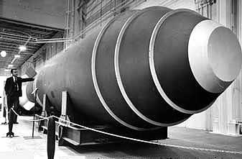

Slide 18
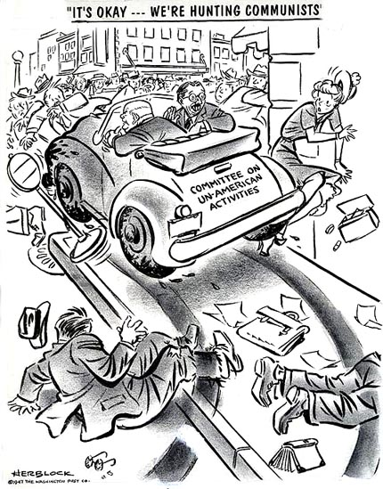

Slide 19
Red Scare-Spy Cases
State Dept. agent Alger Hiss is accused of spying
Soviet defector accuses Hiss of helping Soviets
Charges pursued by Congressman Richard Nixon
Hiss Convicted of perjury
Soviets explode an atomic bomb in 1949
US certain Soviets had spies and traitors here
Physicist Klaus Fuchs admitted in 1950 to helping Soviets
Fuchs says Ethel & Julius Rosenberg helped
Rosenbergs plead 5th Amendment
Both found guilty of treason and sentenced to death
Executed in 1953

Slide 20
McCarthyism
Wisconsin Senator Joseph McCarthy used issue of communism to win re-election
Played on American fears
Claims communists were taking over gov’t
Said he had names of communists in State Department
Also said communists were in US Army
McCarthy never produces any names
He is discredited and censured by Congress for his actions
In 1953 the Crucible play was written as a criticism of the “witch hunt” tactics of McCarthyism.

Slide 21
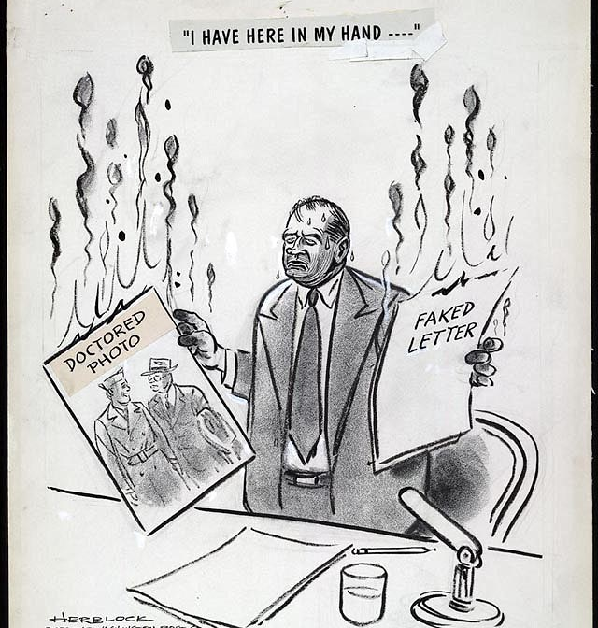

Slide 22
Cold War (Globally)
US uses CIA and spies to gather info and conduct covert operations
Included operations in Iran, Guatemala, etc.
Soviets create Warsaw Pact in 1955 of Eastern European nations
In response to West Germany entering NATO
Egyptian conflict in 1955 over Suez canal
Eisenhower Doctrine issued in 1957
US would defend Middle East from communism
Will not allow Soviets to control most of worlds oil supply
Hungarian Revolts in 1956
Hungary pushes for democracy- call for free elections
Soviets respond by sending in troops and tanks
30,000 Hungarians killed

Slide 23
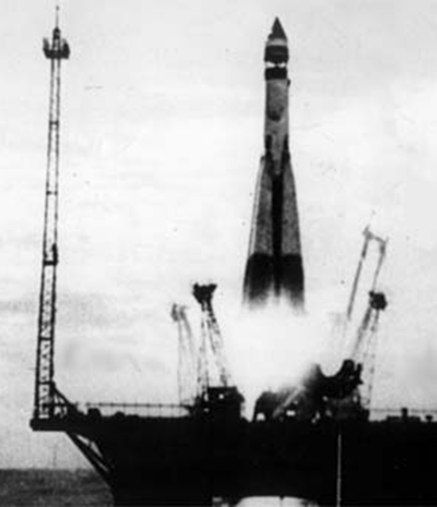
Cold War Competition
Soviets launch 1st satellite in 1957
Sputnik
US is alarmed and begins focusing
on own space program –
NASA is created.
US launches their 1st satellite in 1958
April 1961 Soviets put 1st man
in space
3 weeks later John Glenn is
1st American in space

Slide 24
Spy Planes and Espionage
President Eisenhower & Khrushchev were to have a summit in 1960 to ease tensions
US makes secret flights over Soviet Union
U-2 plane used to take spy photos of troop and missile movement.
American U-2 plane is shot down and pilot Gary Powers is captured.
Eisenhower denies at first, then forced to admit flights.
Soviets demand apology and Khrushchev calls off summit.
Tensions remain high with great distrust and suspicion on both sides.

Slide 25
